Slide 1
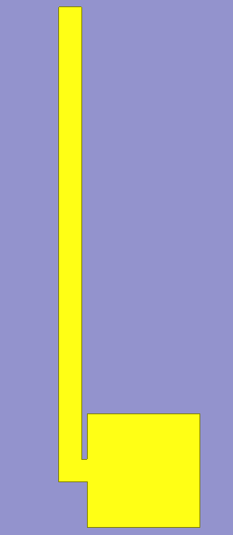
8um
0.4um
0.1um
0.4um
2um
2um
Metal Thickness: 0.11um
ZnS Substrate Thickness: 0.2um

Slide 2
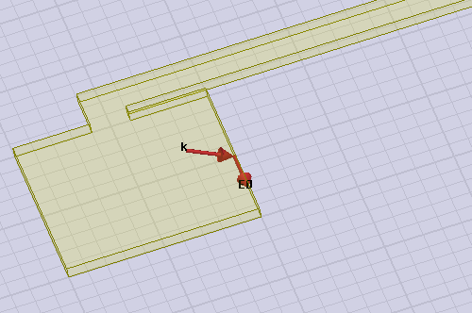
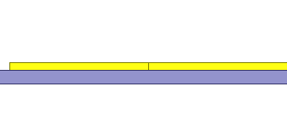




$$\vec{E}$$
$$\vec{K}$$
$$\vec{E}$$
$$\vec{K}$$
3D Incident wave polarization
60º

